Slide 1
Day 21
Linux Device Driver Training
GRAPHS AND TREES
Presented by,
Ganavi M
Ganavigowda512@gmail.com

Slide 2
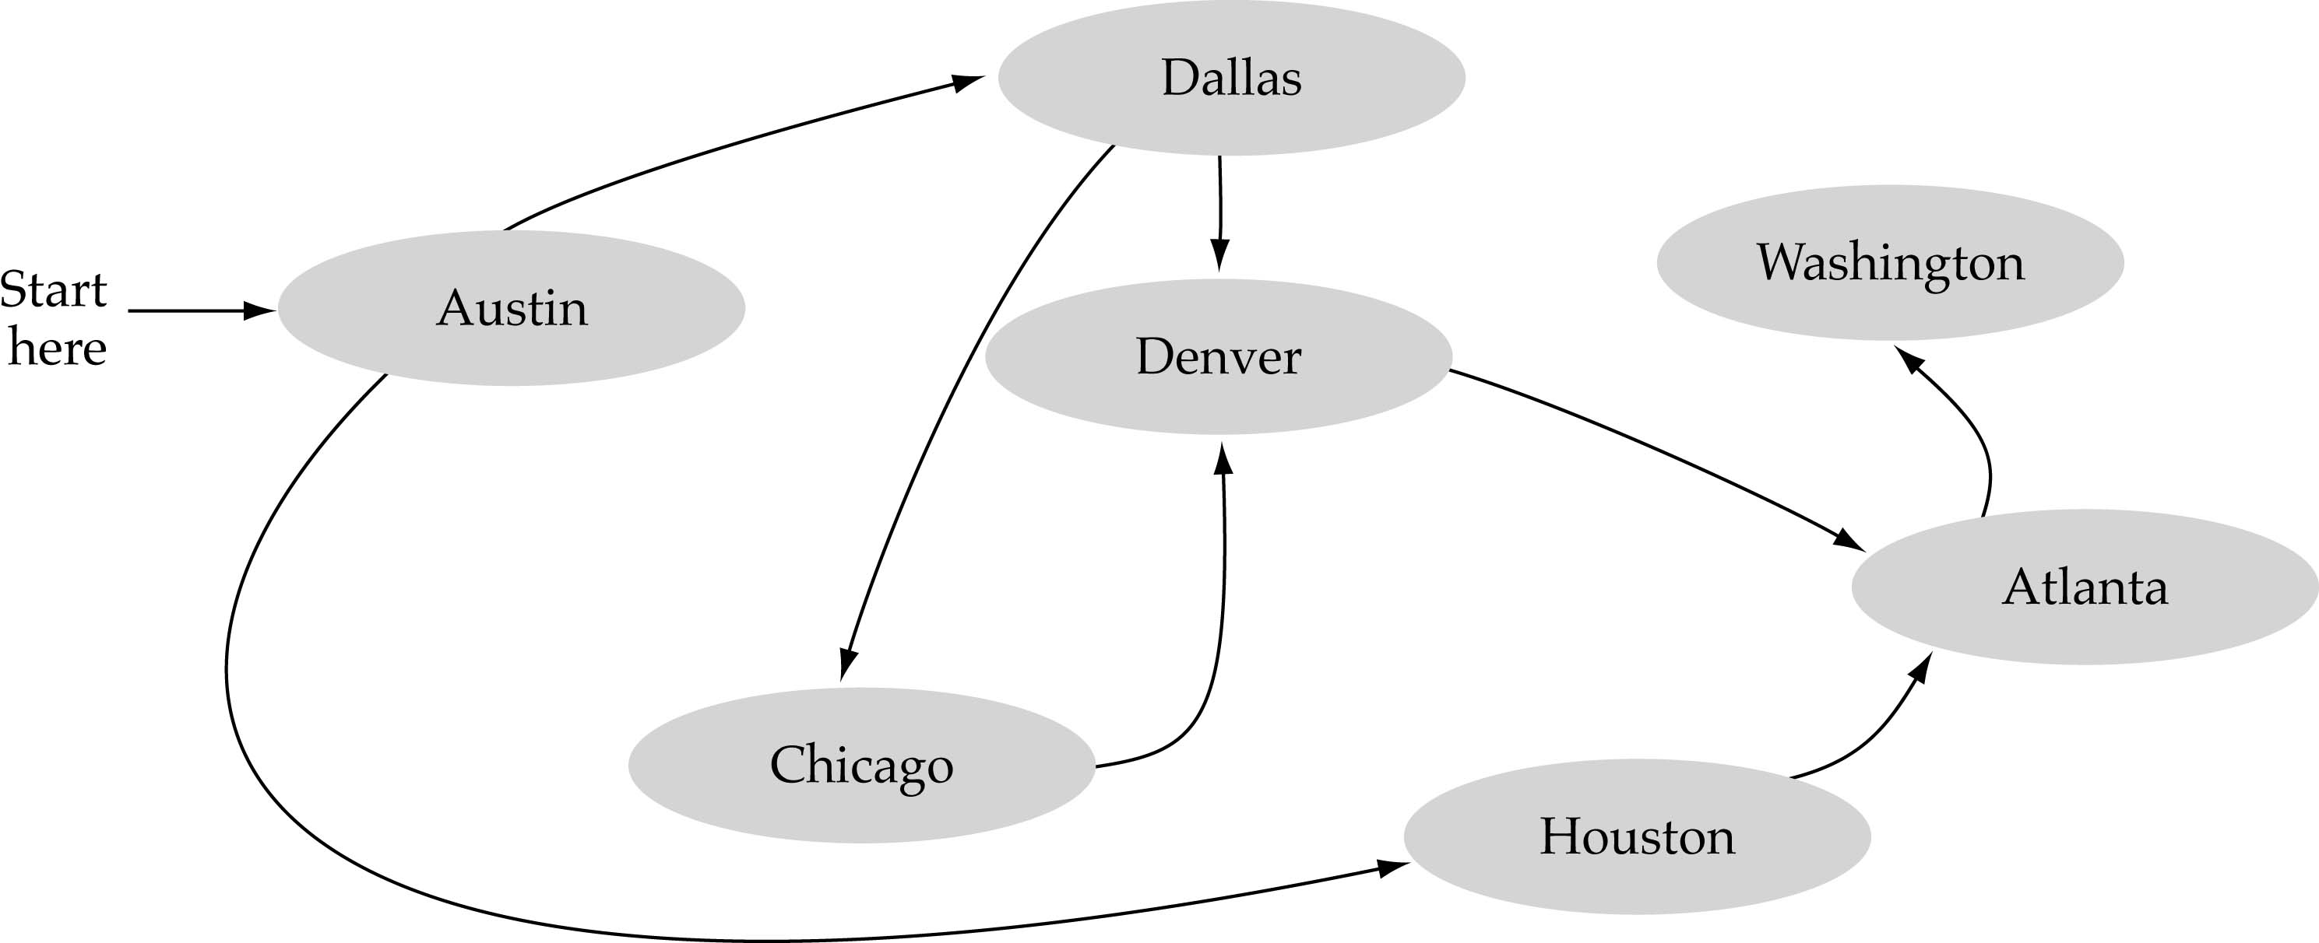
What is a graph?
A data structure that consists of a set of nodes (vertices) and a set of edges that relate the nodes to each other
The set of edges describes relationships among the vertices

Slide 3
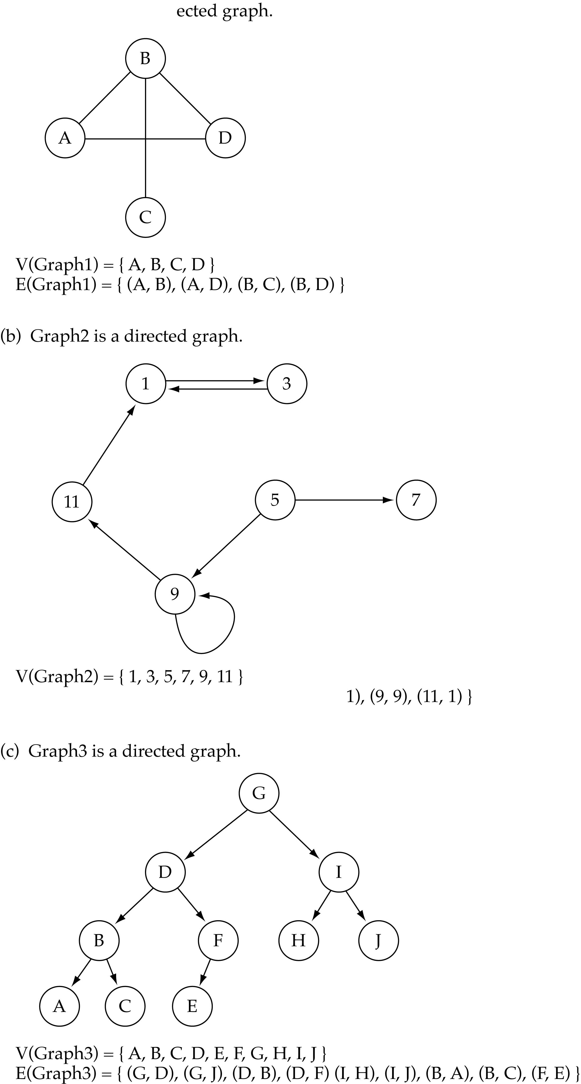
Formal definition of graphs
A graph G is defined as follows:
G=(V,E)
V(G): a finite, nonempty set of vertices
E(G): a set of edges (pairs of vertices)
Directed vs. undirected graphs
When the edges in a graph have no direction, the graph is called undirected

Slide 4
Directed vs. undirected graphs (cont.)
When the edges in a graph have a direction, the graph is called directed (or digraph)
Warning: if the graph is directed, the order of the vertices in each edge is important !!
E(Graph2) = {(1,3) (3,1) (5,9) (9,11) (5,7)

Slide 5
Trees vs graphs
Trees are special cases of graphs!!

Slide 6
Graph terminology
Adjacent nodes: two nodes are adjacent if they are connected by an edge
Path: a sequence of vertices that connect two nodes in a graph
Complete graph: a graph in which every vertex is directly connected to every other vertex
5 is adjacent to 7
7 is adjacent from 5

Slide 7
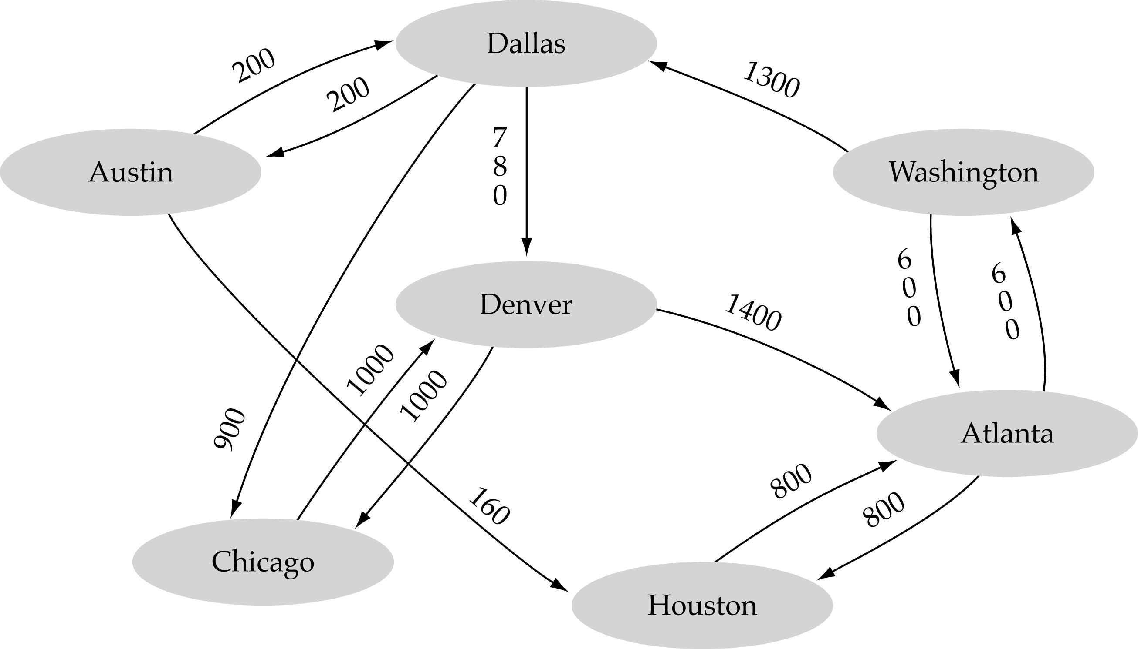
Graph implementation
Array-based implementation
A 1D array is used to represent the vertices
A 2D array (adjacency matrix) is used to represent the edges

Slide 8
Graph implementation (cont.)
Linked-list implementation
A 1D array is used to represent the vertices
A list is used for each vertex v which contains the vertices which are adjacent from v (adjacency list)

Slide 9
Adjacency matrix vs. adjacency list representation
Adjacency matrix
Good for dense graphs --|E|~O(|V|²)
Memory requirements: O(|V| + |E| ) = O(|V|² )
Connectivity between two vertices can be tested quickly
Adjacency list
Good for sparse graphs -- |E|~O(|V|)
Memory requirements: O(|V| + |E|)=O(|V|)
Vertices adjacent to another vertex can be found quickly

Slide 10
Thank you

